Slide 1
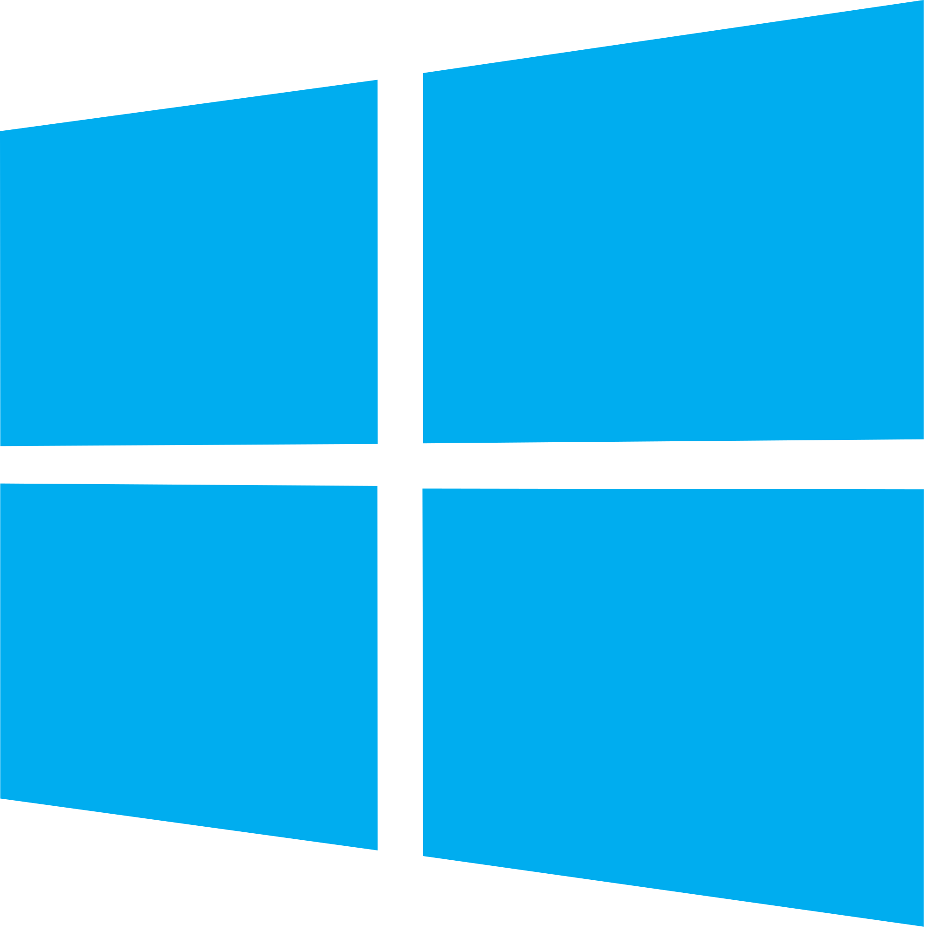


Case study of different bootloaders
Sriram S K - PES1201700097
Shreyas Prashanth - PES1201701249
Sanket HS - PES1201700158
Kevin Arulraj - PES1201700659

Slide 2
Introduction
What is a bootloader?
All bootloaders are simply pieces of software, just like the application code they will help you load on to the processor. Generally speaking, bootloaders are designed to be as small and simple as possible so they do not take up space that otherwise could be used for your application.
Why do we need bootloaders?
It is the program the processor will run when it resets. Its job would be then to: replace the existing application code with a new application, or to start the existing application.

Slide 3

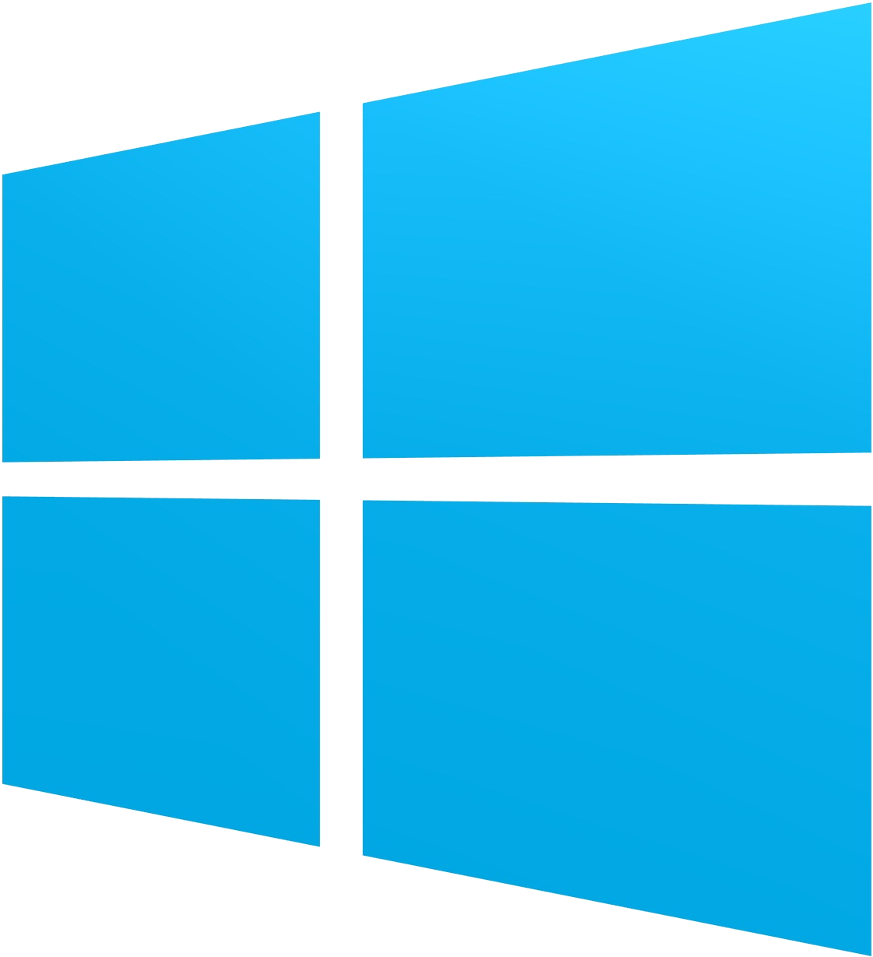
Windows
NTLDR
boot loader for all releases of Windows NT operating system up to and including Windows XP
NTLDR requires, at the minimum, the following 3 files to be on the system volume
When a PC is powered on its BIOS follows the configured boot order to find a bootable device. The code in the boot sector of the active partition could then be again a NTLDR boot sector looking for ntldr in the root directory of this active partition.
BOOTMGR
The Windows boot loader architecture includes a firmware-independent boot configuration and storage system called Boot Configuration Data that has been used since Windows Vista.
It replaced NTLDR with three components:
  BOOTMGR
  Winload.exe
  Winresume.exe

Slide 4
ANDROID
BOOTLOADER

Slide 5
Introduction
The bootloader starts up the android system on your phone.
Comprises of many things including the splash screen, initializing the Trusted Execution Environment(TEE) and verifying the integrity of the boot.

Slide 6
Various aspects of the bootloader
Boot reason
Boot image header versioning
Partition Layout
Fastboot

Slide 7
Boot reason
The android operating system uses uniquely available hardware and memory resources to determine why the device booted.
E.g: the boot record for booting due to long press of the key will be→ “reboot,long key”

Slide 8
Boot image header versioning
The bootloader should check the version and parse the image accordingly.
All devices with android version:
Before 9→ header version 0
With 9 → header version 1
10 → header version 2 (Includes DTB)
Vendor Test Suite (VTS) checks the headers.

Slide 9
Partition Layout
Two types of partition layouts:
A/B
Non A/B
Devices with non A/B layouts has the following partitions:
boot, system, vendor, userdata, cache, recovery, misc

Slide 10
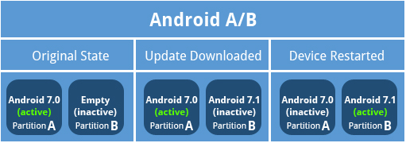
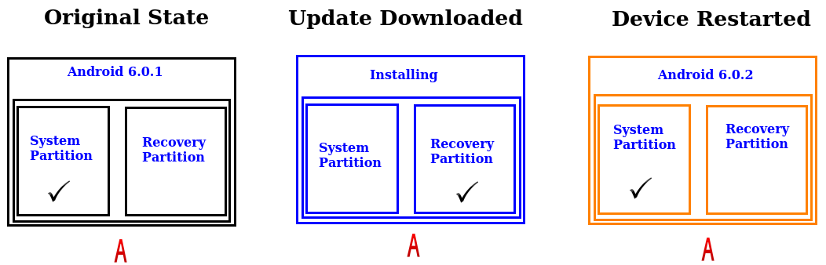

Slide 11
Here is how the bootloader operates:
The bootloader gets loaded first.
The bootloader initializes memory.
If A/B updates are used, determine the current slot to boot.
Determine whether recovery mode should be booted.
The bootloader loads the image, which contains the kernel.
The bootloader starts loading the kernel into memory as a self-executable compressed binary.
The kernel decompresses itself and starts executing into memory.
From /system, init launches and starts mounting all the other partitions and then starts executing code to start the device.

Slide 12
Fastboot
Fastboot is a protocol that can be used to re-flash partitions on your device.
It can start even if the android isn’t installed at all and the files can be modified from computer over a USB connection.
Different from recovery mode.

Slide 13
GRUB

Slide 14
Grand Unified Bootloader
It is a boot loader package which provides a user the choice to boot one of multiple operating systems installed on a computer or select specific kernel configuration available on a particular operating system's partitions.
It is predominantly used for Unix-based systems.

Slide 15
GRUB was intended to boot operating systems that conform to the Multi-boot Specification.
The Multi-boot Specification is an open standard describing how a boot loader can load an x86 operating system kernel.
In addition to multi boot-conforming systems, GRUB can boot directly to Linux, FreeBSD, etc.
It can boot Windows using chainloading.

Slide 16
Grub Interfaces
It provides both menu-driven and command-line interfaces to perform these functions.
The command line interface is accessible both while the system is booting and from the command line once the os is running.

Slide 17
GRUB boot process
Stage 1 is the piece of GRUB code that resides in the MBR(Master Boot Record) or the boot sector of another partition or drive. Since the main portion of GRUB is too large to fit into the 512 bytes of a boot sector, Stage 1 is used to transfer control to the next stage, either Stage 1.5 or Stage 2.

Slide 18
Stage 1.5 is loaded by Stage 1 only if the hardware requires it. Stage 1.5 is filesystem specific; that is, there is a different version for each filesystem that GRUB can load. Stage 1.5 image contains filesystem drivers, stage 1.5 loads Stage 2.
Stage 2 runs the main body of the GRUB code. It displays the menu, lets you select the operating system to be run, and starts the system you’ve chosen.

Slide 19
Naming Conventions
Drives are numbered starting from 0; thus, the first hard drive is hd0, the second hard drive is hd1, the first floppy drive is fd0, and so on.
Partitions are also numbered from 0, and the entire name is put in parentheses.
So the first partition of the first drive, /dev/hda1, is known as (hd0,0) to GRUB.

Slide 20
GRUB Configuration file
The images of the different OS are in the grub.conf file.
default=0
timeout=5
splashimage=(hd0,0)/grub/splash.xpm.gz
hiddenmenu
title Red Hat Enterprise Linux Server (2.6.18-238.el5)
root (hd0,0)
kernel /vmlinuz-2.6.18-238.el5 ro root=/dev/VolGroup00/LogVol00 root=/dev/VolGroup00/LogVol00
initrd /initrd-2.6.18-238.el5.img

Slide 21
Xv6 Bootloader

Slide 22
The Xv6 Bootloader consists of two main components:
Assembly Bootloader (bootasm.S)
Switches modes from Real Mode to Protected Mode, initializes stack for the C Bootloader.
C Bootloader (bootmain.c)
Loads .elf headers, kernel binary into memory. Checks if binary is .elf file. Does not return. Hands over control to kernel.

Slide 23
Drawbacks:
One assumption made is that kernel is stored contiguously, which is rarely the case.
Accessing kernel spread over multiple sectors is beyond ability of basic bootloader limited to 512 bytes.
Thus, we have a 2-step bootloader. First bootloader runs in Real mode and loads the secondary bootloader in Protected mode. The secondary bootloader is unconstrained by the 512-byte limit and can implement the complexity required to boot the kernel.

Slide 24
Alternative:
UEFI (Unified Extensible Firmware Interface)
Defines software interface between operating system and firmware. Replaces Legacy BIOS.
Does not rely on a boot sector. Instead, it utilizes a boot manager. Eg. Windows BOOTMGR.EXE

Slide 25
Implementing a basic Bootloader

Slide 26
Requirements:
nasm - Netwide Assembler - Assembler for x86 architecture
Qemu - Quick Emulator
We use a floppy disk bootloader as it is simple and does not require a file system.

Slide 27
Switching to Protected Mode using BIOS interrupts.
mov ax, 0x2401
int 0x15 ; enable A20 bit
mov ax, 0x3
int 0x10 ; set vga text mode 3

Slide 28
Enable access to all 32 registers using Global Descriptor Table
Writing to the monitor

Slide 29
